Slide 1
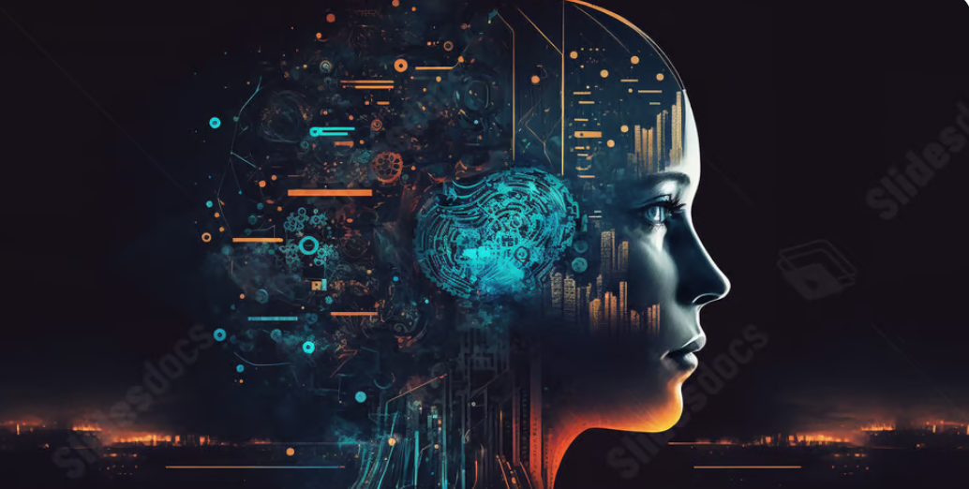
Artificial Intelligence

Slide 2
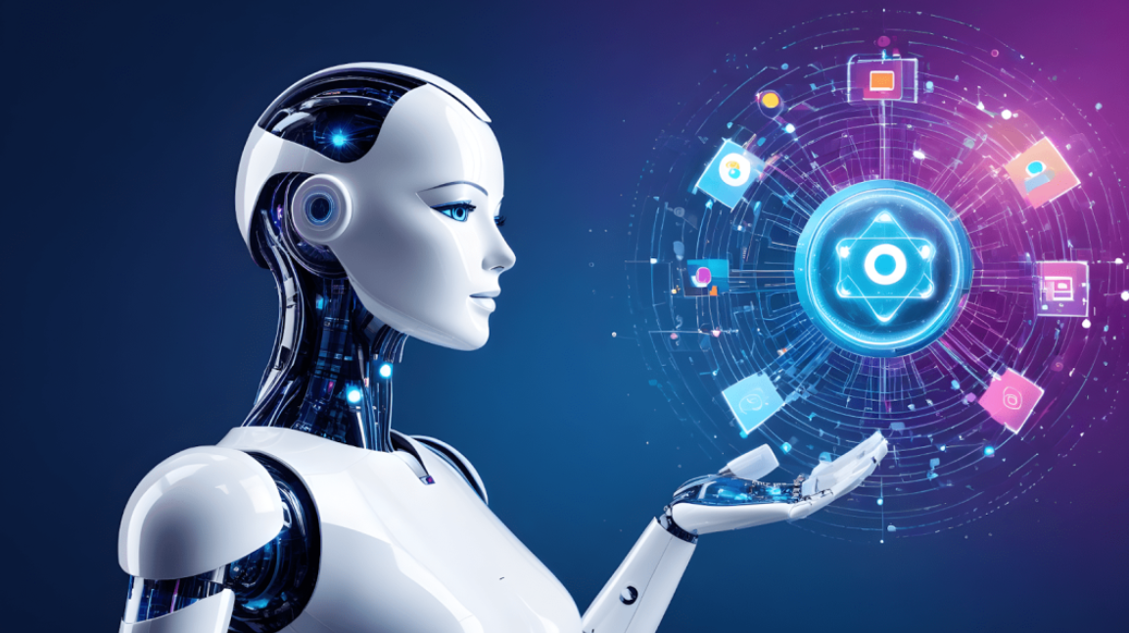
Definition of AI AI is the ability of a computer or machine to perform tasks that normally require human intelligence, such as learning, reasoning, and problem-solving. Example: Virtual assistants (Alexa, Siri), self-driving cars
Introduction of AI

Slide 3
A brief history of AI
1950s
Beginning of AI concept
2000
Machine learning and automation
Today
Generative AI and deep learning

Slide 4
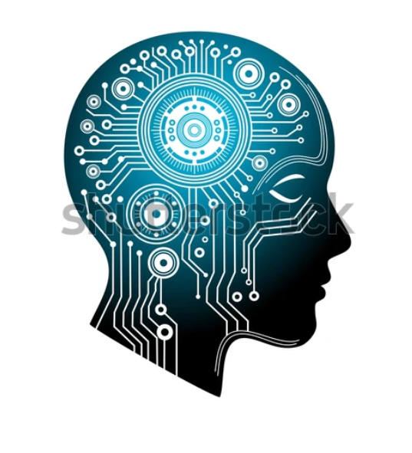
AI in Daily Life
Involvement in travel Application
Helping us with emails
Mobile Banking
Mobile Application
Social Networking
Improve the online shopping

Slide 5
Positive Impacts of AI
Negative Impacts of AI
Data privacy concerns
Over-dependence on technology
Job displacement
Healthcare: Early disease detection
Education: Personalized learning
Agriculture: Smart farming
Industry: Automation & efficiency
Environment: Energy management

Slide 6
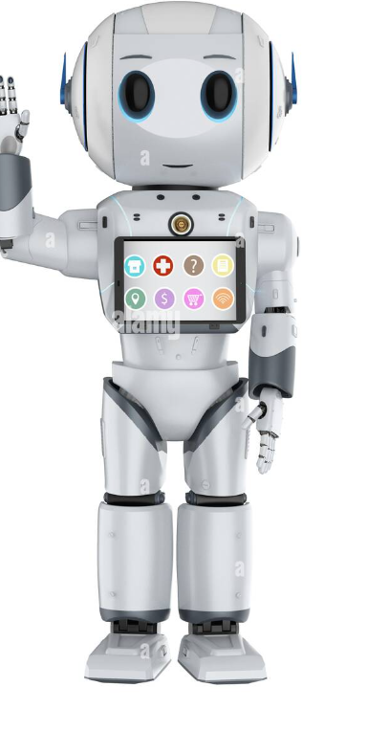

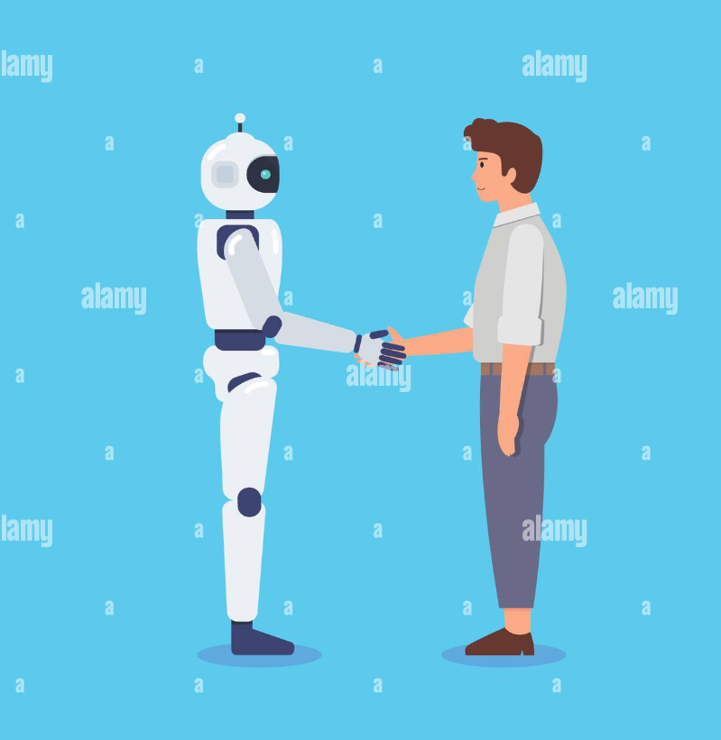

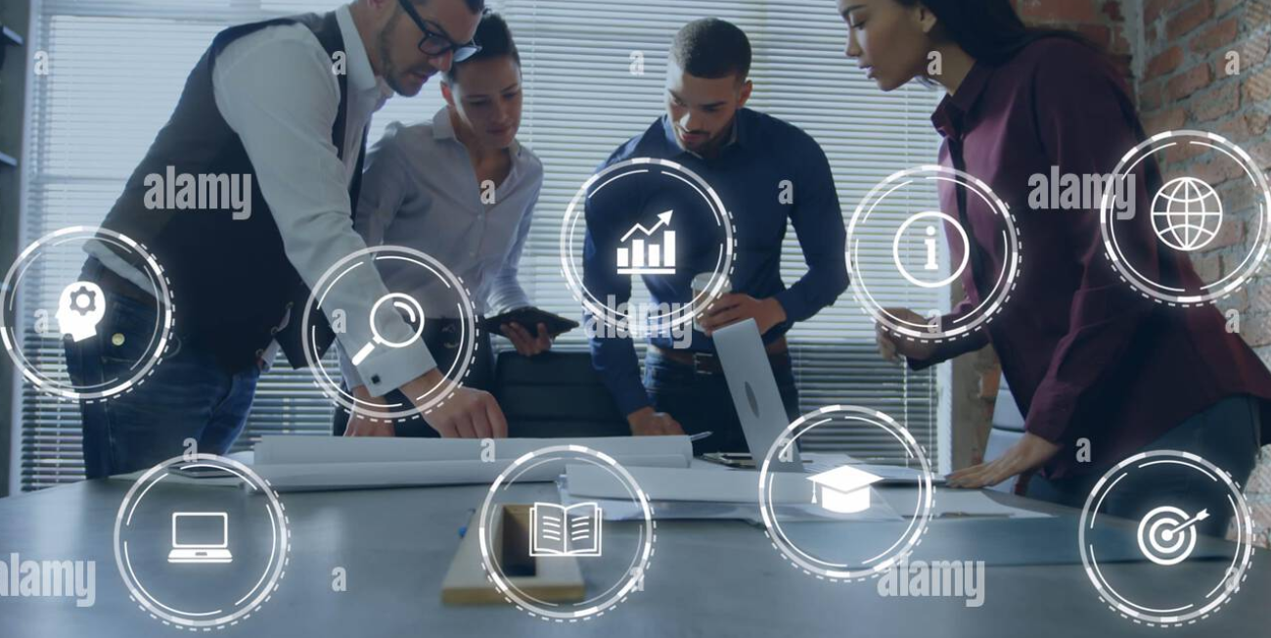
Future of AI
Robot Assistants Cyber Security Human–AI collaboration
Health care Digital Marketing

Slide 7
Ethics in data collection
Risks of bias
Challenges of using AI
Potential for misuses
Cybersecurity threats
Lack of transparency
Regulatory framework and standards

Slide 8
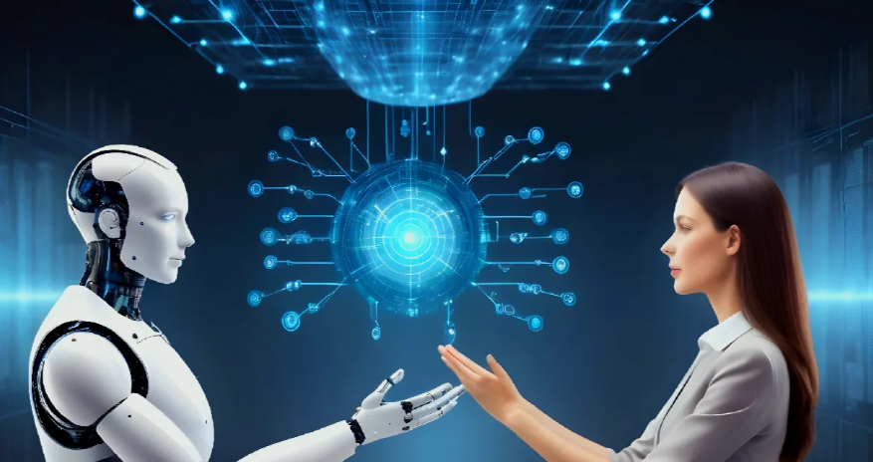
Conclusion
Artificial Intelligence is changing the world in every field.
It helps improve our daily lives through smart and efficient systems.
AI offers great benefits, but it must be used responsibly and ethically.
The future of AI is bright when guided by human values and creativity.

Slide 9


